Slide 1
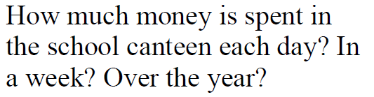
How many people do you think use the canteen each day?
How much money do you think they would spend each time?
How many days a week does the canteen run?
How many weeks in a school year?
So how much is spent at the canteen in a day, a week and a year?
If the proceeds are split equally, how much would each person at the canteen get?

Slide 2
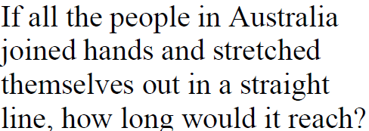
How many people do you think are in Australia?
How big is an average arm span?
So how far would they reach?
Added question – how many time around the equator is this?

Slide 3
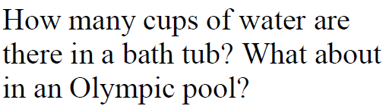
How big much volume is in a cup?
How many cups are needed to make a litre?
How many litres in an Olympic sized swimming pool?
How many cups are needed to fill an Olympic swimming pool?
Added Question – how long would it take 1 person to drink?

Slide 4
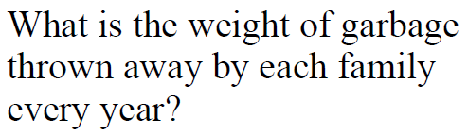
How big is the average family?
How many bags or rubbish would they throw out each week?
How much would those bags weigh?
So how much does each family use?
Added Question – How much rubbish would each household in Australia make each year?

Slide 5
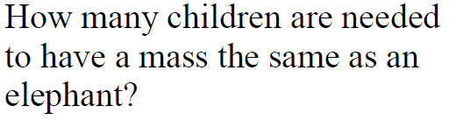
What type of elephant?
What is the average weight of an elephant
What would you consider as the weight of the children?
How many children make up the weight of the elephant?
Added question – How many children would it take to fit the elephant?

Slide 6
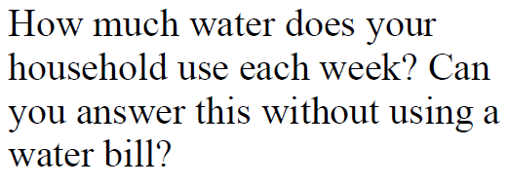
What are the ways you use water each day?
How much water does each activity use?
How many others in the family do the same activities?
How much water does everyone use each day?
How much each week?
Extra question – how long weeks would it take to use an olympic swimming pool?

Slide 7
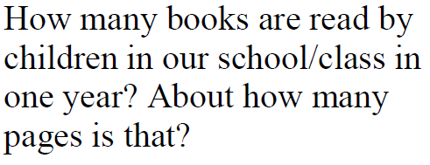
How many books do you read a week?
Do others read more or less?
How many pages do you think that would be for each week?
How many students in a class?
How many students in the school?
So the answer is…..
Added question – how long would it take to read through the entire school library?

Slide 8
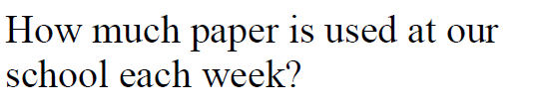
How many pages are you given each day?
How many days a term? How many days each school year.?
How many students are there in the school?
What are people might receive paper each day?
How much do you expect they might use?
Total answer is..
Extra Question – what percentage do you think will get recycled?

Slide 9
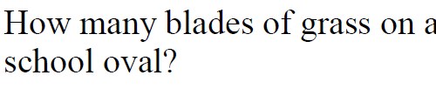
How many blades in a square centimetre?
How many centimetres in a square meter?
What is the length and width of a school oval?
So how many square meters are in a school oval?
So how many blades of grass on a school oval?
Extra Question – How many blades of grass are cut every second while it is getting mowed?

Slide 10
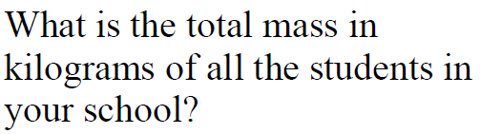

Slide 11


Slide 12
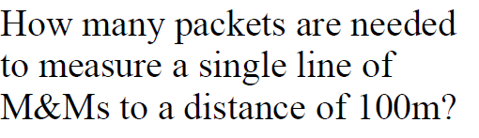

Slide 13
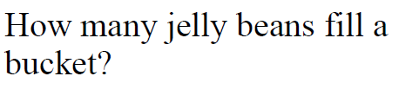

Slide 14
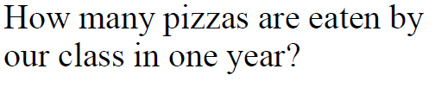

Slide 15
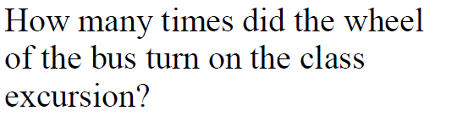

Slide 16


Slide 17
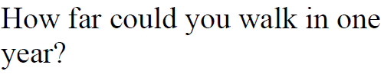

Slide 18


